Slide 1
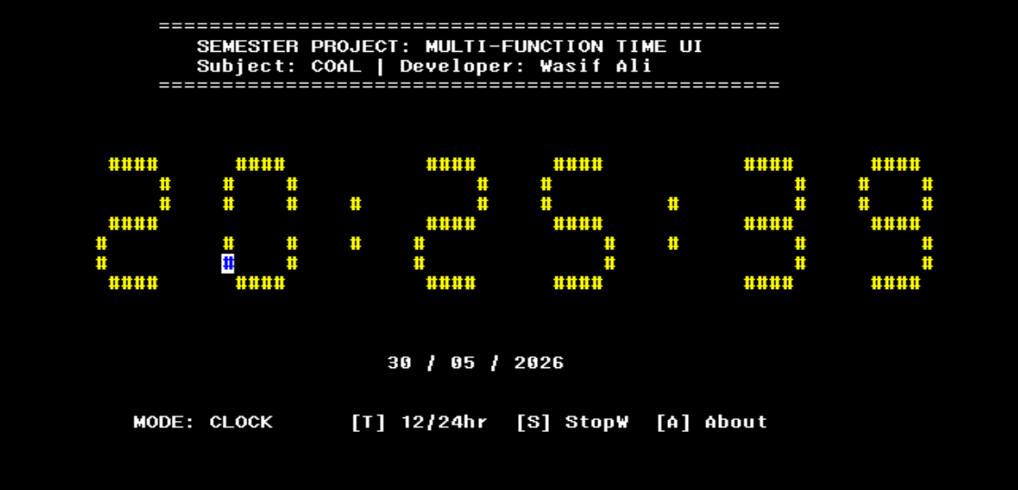
COAL SEMESTER PROJECT
Real-Time Digital
Clock & Stopwatch
7-Segment ASCII UI · Live Date Display · 12/24 Hr Toggle · Mode State Machine
Developer: Wasif Ali Instructor: Sir Imran
Subject: Computer Organization & Assembly Language Institution: Air University
Assembly x86 · Irvine32 Library · MASM

Slide 2
OVERVIEW
Table of Contents
01
Project Overview & Objectives
06
State Machine & Input Handler
02
System Architecture & Design
07
Key Data Structures
03
7-Segment Rendering Engine
08
Demo Walkthrough & Screenshots
04
Clock Mode — Core Logic
09
Challenges & Solutions
05
Stopwatch Module
10
Conclusion
2

Slide 3
01 PROJECT OVERVIEW
What Was Built
🕐 Live Clock
⏱ Stopwatch
📺 7-Segment UI
Fetches real system time via GetLocalTime Win32 API; updates every ~50 ms
Millisecond-precision timer using GetMSeconds; tracks MM:SS:CC
ASCII '#' blocks render each digit across 6 rows × 6 columns on screen
🔀 12/24 Hr Toggle
🎨 Color Cycling
📋 3-Mode System
Full AM/PM detection with midnight & noon edge-case handling
Text color cycles through palette each second; pauses on stopped stopwatch
Clock, Stopwatch, and About screens managed by a state machine
Switches between multiple operating modes through a keyboard-driven state machine.
3

Slide 4
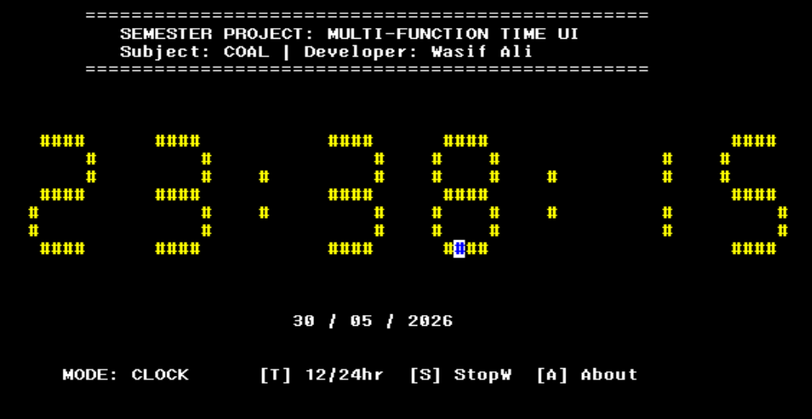
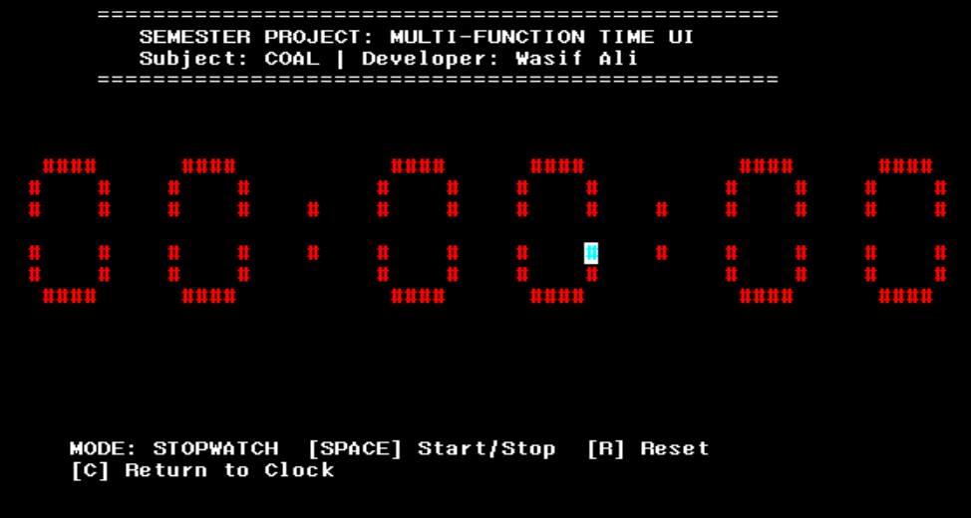
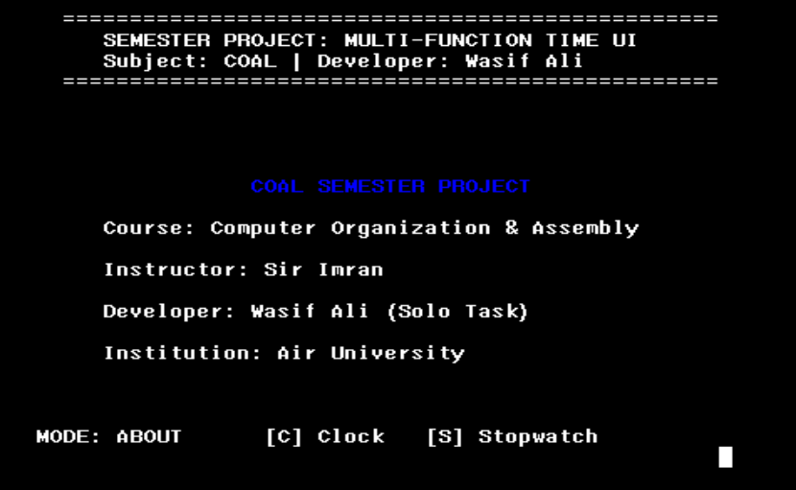
02 SYSTEM ARCHITECTURE
Program Flow & Module Map
HandleInput
(State Machine)
Main Loop
GetLocalTime
(Win32 API)
Mode 0
Clock
Mode 1
Stopwatch
Mode 2
About
DrawHugeDigit
DrawColon
DrawDate
GetMSeconds
CalcTime
DrawHugeDigit
WriteString
(credits)
4

Slide 5
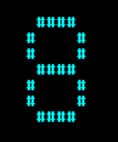
03 7-SEGMENT ENGINE
Drawing Digits with ASCII Blocks
Segment → Procedure Mapping
Segment | Procedure | Console Position | Characters
A (Top) | SegA PROC | baseX+1, baseY | 4× '#'
B (Upper-R) | SegB PROC | baseX+5, baseY+1..2 | 1× '#'
C (Lower-R) | SegC PROC | baseX+5, baseY+4..5 | 1× '#'
D (Bottom) | SegD PROC | baseX+1, baseY+6 | 4× '#'
E (Lower-L) | SegE PROC | baseX, baseY+4..5 | 1× '#'
F (Upper-L) | SegF PROC | baseX, baseY+1..2 | 1× '#'
G (Middle) | SegG PROC | baseX+1, baseY+3 | 4× '#'
A
F
B
G
E
C
D
Visual: Digit '8'
(all 7 segments active)
5

Slide 6
04 CLOCK MODE
Time Rendering & 12/24-Hr Logic
12-Hour Conversion Logic
Assembly Implementation
Get sysTime.wHour
(+12 Wine fix)
; Hour display with 12-hr logic
movzx eax, sysTime.wHour
add eax, 12 ; Wine +12 fix
cmp eax, 24
jb TimeFixed
sub eax, 24 ; wrap past midnight
TimeFixed:
cmp is12Hour, 1
jne DrawHoursNormal
mov isPM, 0
cmp eax, 12
jb CheckMidnight
mov isPM, 1
je DrawHoursNormal ; exactly noon
sub eax, 12 ; PM hours
jmp DrawHoursNormal
CheckMidnight:
cmp eax, 0
jne DrawHoursNormal
mov eax, 12 ; midnight → 12 AM
is12Hour == 1?
hour >= 12 ?
Set isPM = 1
hour == 12 ?
Keep as 12
hour == 0 ?
Set 12 (midnight)
💡 The +12 Wine Environment Fix compensates for Wine's system time reporting bug where hours appear as AM only.
6

Slide 7
05 STOPWATCH MODULE
Precision Timing with State Control
Stopwatch State Machine
Start / Pause Implementation
IDLE
swState = 0
SPACE
RUNNING
swState = 1
ToggleStopwatch:
cmp currentMode, 1
jne NoInput
xor swState, 1 ; flip 0↔1
cmp swState, 1
jne Pausing
; --- START ---
call GetMSeconds
mov timeStart, eax
ret
Pausing:
; --- PAUSE ---
call GetMSeconds
sub eax, timeStart
add timeElapsed, eax
ret
ResetStopwatch:
mov swState, 0
mov timeElapsed, 0
mov timeStart, 0
ret
SPACE
RESET
[R] key
Time Calculation Algorithm
Total ms = GetMSeconds() − timeStart + timeElapsed
Minutes = Total ms ÷ 60,000
Seconds = Remainder ÷ 1,000
Centiseconds = Final remainder ÷ 10
7

Slide 8
06 STATE MACHINE & INPUT
Keyboard-Driven Mode Controller
Key Bindings
HandleInput — Core Logic
Key | Action | Allowed In
ESC | Quit Program | Any mode
C / c | Switch to Clock | Any mode
S / s | Switch to Stopwatch | Any mode
A / a | Switch to About | Any mode
T / t | Toggle 12/24 Hour | Clock only
SPACE | Start / Pause Stopwatch | Stopwatch only
R / r | Reset Stopwatch | Stopwatch only
HandleInput PROC
call ReadKey
jz NoInput ; no key pressed
cmp al, 27
je QuitProg ; ESC → exit
cmp al, 'c'
je SwitchToClock
cmp al, 'C'
je SwitchToClock
; ... S/s A/a T/t R/r SPACE ...
SwitchToClock:
cmp currentMode, 0
je NoInput ; already here
mov currentMode, 0
mov needsClear, 1 ; trigger redraw
ret
Toggle12Hour:
cmp currentMode, 0
jne NoInput ; clock mode only
xor is12Hour, 1
mov needsClear, 1
ret
State Variables
currentMode (0=Clock, 1=Stopwatch, 2=About) · swState (0=Idle, 1=Running) · needsClear (redraw flag) · is12Hour (format toggle)
8

Slide 9
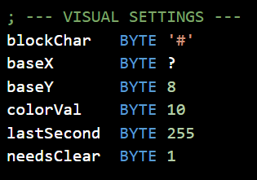
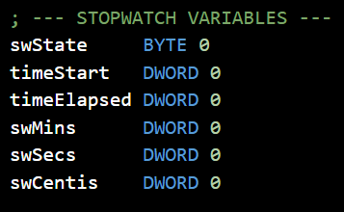
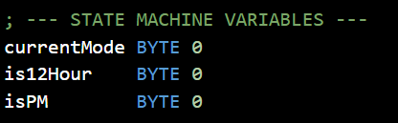
07 DATA STRUCTURES
Key Variables in the .data Segment
Visual / Rendering
Stopwatch Timing
blockChar
BYTE
'#'
Character used to paint all segments
timeStart
DWORD
0
GetMSeconds value when SW started
baseX
BYTE
?
Current digit's X screen column
timeElapsed
DWORD
0
Accumulated ms across pause cycles
baseY
BYTE
8
Fixed Y row for digit top row
swMins
DWORD
0
Computed display: minutes
colorVal
BYTE
10
Console text color (cycles 9–15)
swSecs
DWORD
0
Computed display: seconds
lastSecond
BYTE
255
Detects new second for color cycle
swCentis
DWORD
0
Computed display: centiseconds
needsClear
BYTE
1
Flag: 1 = full screen redraw needed
Code View
State Control
currentMode
BYTE
0
Active screen (0 Clock, 1 SW, 2 About)
is12Hour
BYTE
0
0 = 24hr mode, 1 = 12hr mode
isPM
BYTE
0
0 = AM, 1 = PM (set by 12hr logic)
swState
BYTE
0
0 = stopped, 1 = running
9

Slide 10
08 PROCEDURE REFERENCE
All Procedures at a Glance
Procedure | Purpose | Calls
main | Entry point; hosts main loop and mode dispatcher | HandleInput, DrawUIHeader, all modes
DrawUIHeader | Prints static header (title, author, border) | WriteString, Gotoxy
HandleInput | Reads keyboard; drives currentMode state machine | ReadKey, GetMSeconds
WriteZeroPadded | Prints numbers with leading zero (e.g. 09) | WriteChar, WriteDec
DrawHugeDigit | Dispatches to correct segment combination for 0–9 | ClearDigitArea, SegA–SegG
ClearDigitArea | Blanks 7 rows × 6 cols before each digit redraw | Gotoxy, WriteChar
SegA / SegD | Top and bottom horizontal segments (4 chars wide) | Gotoxy, WriteChar
SegB / SegC | Right vertical segments (upper & lower) | Gotoxy, WriteChar
SegE / SegF | Left vertical segments (upper & lower) | Gotoxy, WriteChar
SegG | Middle horizontal segment (4 chars wide) | Gotoxy, WriteChar
DrawColon | Draws ':' separator between digit pairs | Gotoxy, WriteChar
10

Slide 11
09 CHALLENGES & SOLUTIONS
Engineering Decisions
01
Wine Environment Time Bug
02
12-Hour Edge Cases (Noon & Midnight)
Manually added 12 to wHour with modulo 24 wrap-around to compensate for Wine's broken AM-only time reporting.
add eax, 12
cmp eax, 24
jb TimeFixed
sub eax, 24
Separate branches check for exactly 00:00 (convert → 12 AM) and exactly 12:00 (keep as 12 PM), preventing 0 AM and 12 → 0 PM bugs.
cmp eax, 0
je SetNoon
cmp eax, 12
je DrawHoursNormal
03
Screen Flicker During Redraws
04
Stopwatch Accuracy Across Pauses
needsClear flag defers Clrscr to the next loop iteration only when mode changes, not every 50 ms. Digit areas are cleared individually.
cmp needsClear, 1
jne SkipClear
call Clrscr
mov needsClear, 0
timeElapsed accumulates each paused segment. On resume, a fresh timeStart snapshot is taken so elapsed time is preserved correctly.
sub eax, timeStart
add timeElapsed, eax
11

Slide 12
COAL Semester Project · Air University · Developer: Wasif Ali · Instructor: Sir Imran
10 CONCLUSION
What Was Achieved
✅
Real-Time Clock
System time fetched via Win32 GetLocalTime API and rendered as large 7-segment digits
✅
12/24 Hr Toggle
Full AM/PM logic with bullet-proof midnight and noon edge cases
✅
Functional Stopwatch
Centisecond precision, start/pause/resume/reset, state preserved across pauses
✅
Dynamic Color UI
Per-second color cycling paused intelligently on stopwatch stop
✅
Clean Architecture
State-machine input handler, modular PROC design, needsClear redraw optimization
✅
Assembly Mastery
Irvine32 I/O, Win32 API calls, BYTE/DWORD state, DIV arithmetic, register hygiene
12

